Slide 1

Intelligent Waste Management Vision based multi-class segmentation with robotic manipulator and LLM-driven waste processing insights
Team – D03
Naren Sundar L – CB.SC.U4AIE23322
Renny Harlin D – CB.SC.U4AIE23334
Vatturu Pardheev – CB.SC.U4AIE23344
Charuvarthan T – CB.SC.U4AIE23359

Slide 2
Introduction
Global Waste Management Challenges
Manual Sorting Issues
Need for Automation

Slide 3
Objectives
Automate waste classification using Robotics and AI
Enhance waste based segregation using vision based segmentation model
Implement robotic manipulator for waste disposal

Slide 4
Control System
Robotic manipulator control
Singularity analysis
Real time decision making
Components used:
Ufactory Lite 6
Rasperry pi
End-effector (Suction cup)

Slide 5
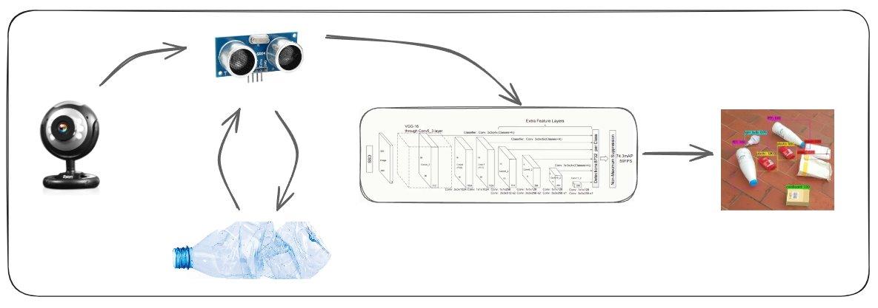
Sensor Data
Camera Input​
Detection model​
Ultrasonic sensor​

Slide 6
Literature Review
S.No | Authors | Year | Title | Observation
1. | W. Liu et al. | 2016 | SSD: Single Shot MultiBox Detector | Introduced a single-shot object detection method using a series of convolutional layers to predict object categories and bounding boxes at multiple scales.
2. | J. Redmon et al. | 2016 | You Only Look Once: Unified, Real-Time Object Detection | Introduced YOLO, a single neural network which predicts object class and location in a single pass, significantly improving detection speed.
3. | Z. Jin and P. Pagilla | 2018 | Collaborative Operation of Robotic Manipulators with Human Intent Prediction and Shared Control | Developed a system where robotic manipulators use sensor data and machine learning to predict human intent, enabling shared human-robot control.

Slide 7
S.No | Authors | Year | Title | Observation
4. | Y.-M. Chang, C.-H. Li, and Y-F. Hong | 2019 | Real-Time Object Coordinate Detection and Manipulator Control Using Rigidly Trained Convolutional Neural Networks | Visual-position control scheme that employs convolutional neural networks (ConvNets) trained with rigid 3D coordinate information
5. | J. Bai et al. | 2020 | Deep Learning Based Robot for Automatically Picking Up Garbage on the Grass | Developed a robot equipped with a deep neural network for garbage recognition and ground segmentation.
6. | J. Liu et al. | 2021 | Garbage Collection and Sorting with a Mobile Manipulator using Deep Learning and Whole-Body Control | Combining deep learning with whole-body control to enable effective autonomous garbage collection and sorting.
7. | B. Yan et al. | 2021 | A Real-Time Apple Targets Detection Method for Picking Robot Based on Improved YOLOv5 | Enhanced the YOLOv5 algorithm to improve real-time detection of apples in orchards by optimizing the network structure.

Slide 8
S.No | Authors | Year | Title | Observation
8. | Qiang Zhang et al. | 2022 | A multi-label waste detection model based on transfer learning | Constructed a multi-label waste image dataset and proposed a YOLO-WASTE model utilizing transfer learning.
9. | Azza Elsayed Ibrahim et al. | 2024 | Object Detection-based Automatic Waste Segregation using Robotic Arm | The system utilizes object detection algorithms to recognize different types of waste and processes visual data to classify them. A robotic arm then segregates the waste into appropriate categories for efficient disposal.
10. | Kangabam et al. | 2024 | Detection and Segregation of Plastic Waste using a Robotic Arm. | Image processing techniques to identify plastic items and controls the robotic arm to separate them from other waste materials.

Slide 9
Research Gap
Lack of integration for waste composition insights and processing methods
Inadequate classification capabilities for multi-material waste sorting
Struggle to accurately detect and classify diverse waste materials in unstructured environments
Challenges in chemical composition identification

Slide 10
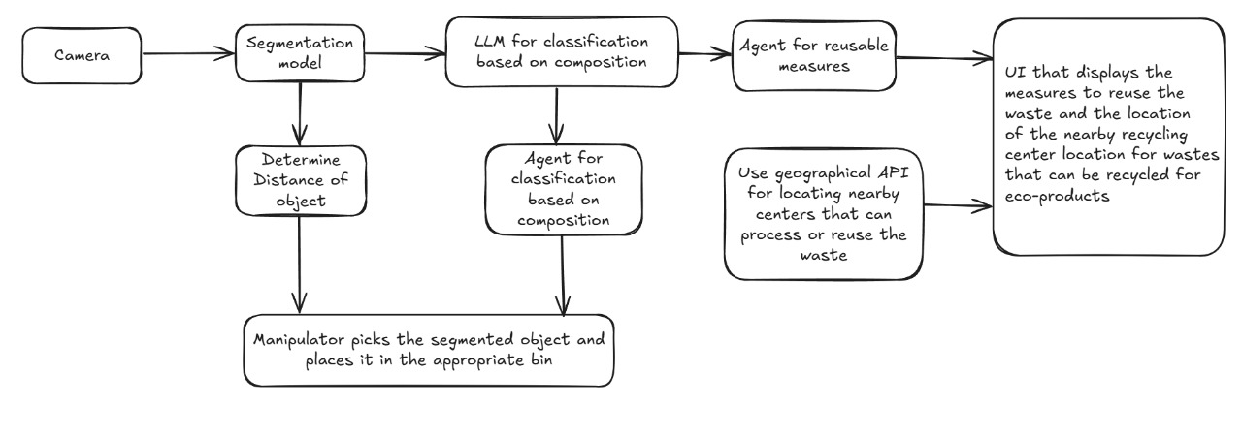
Methodology

Slide 11
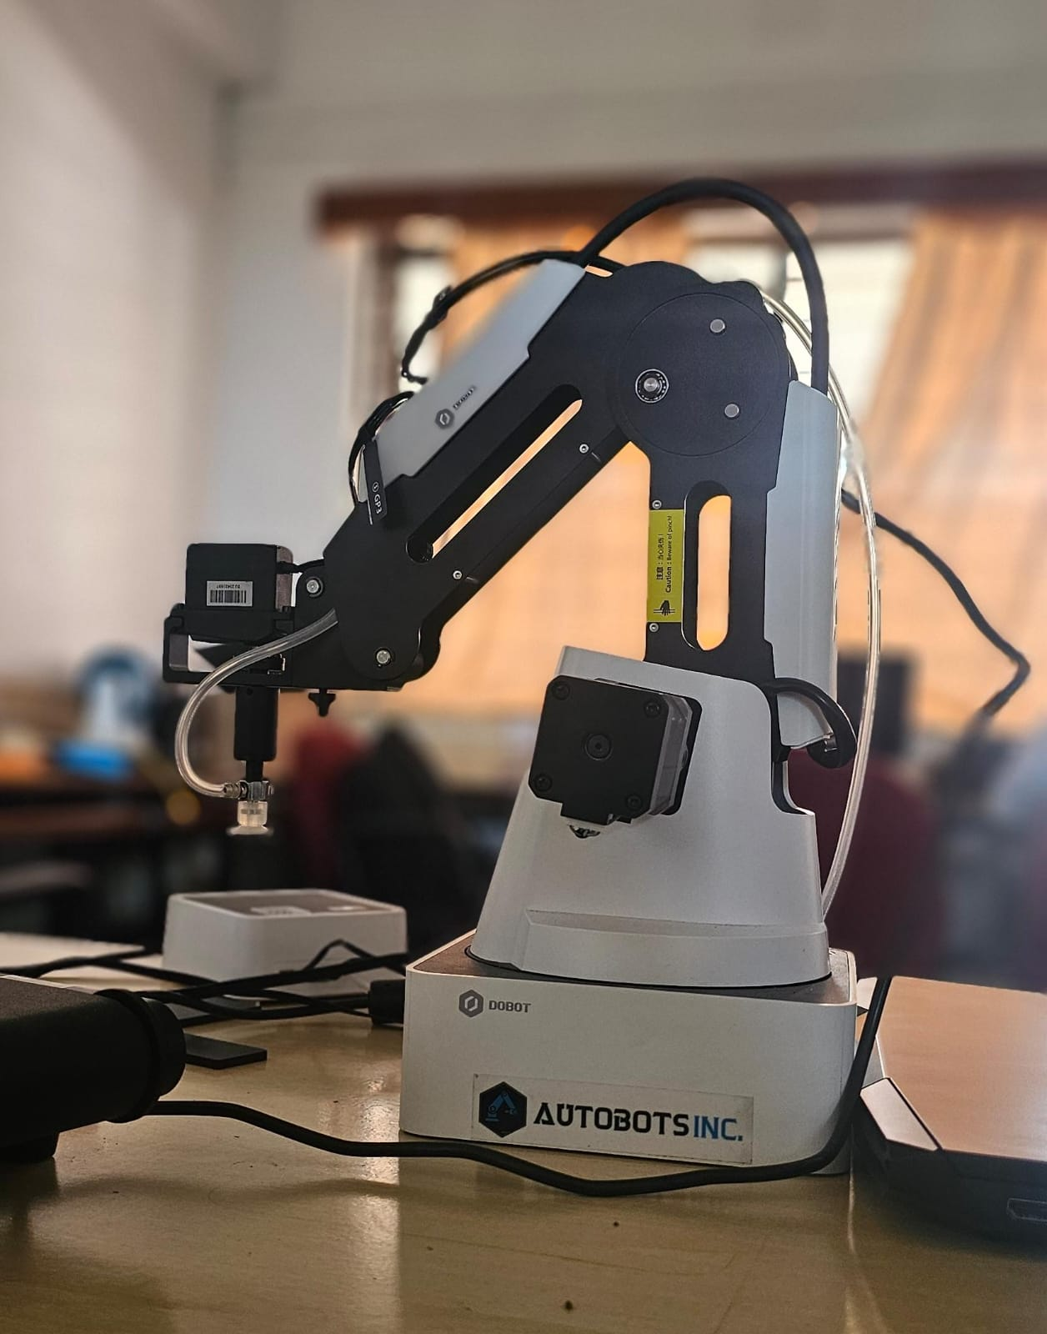
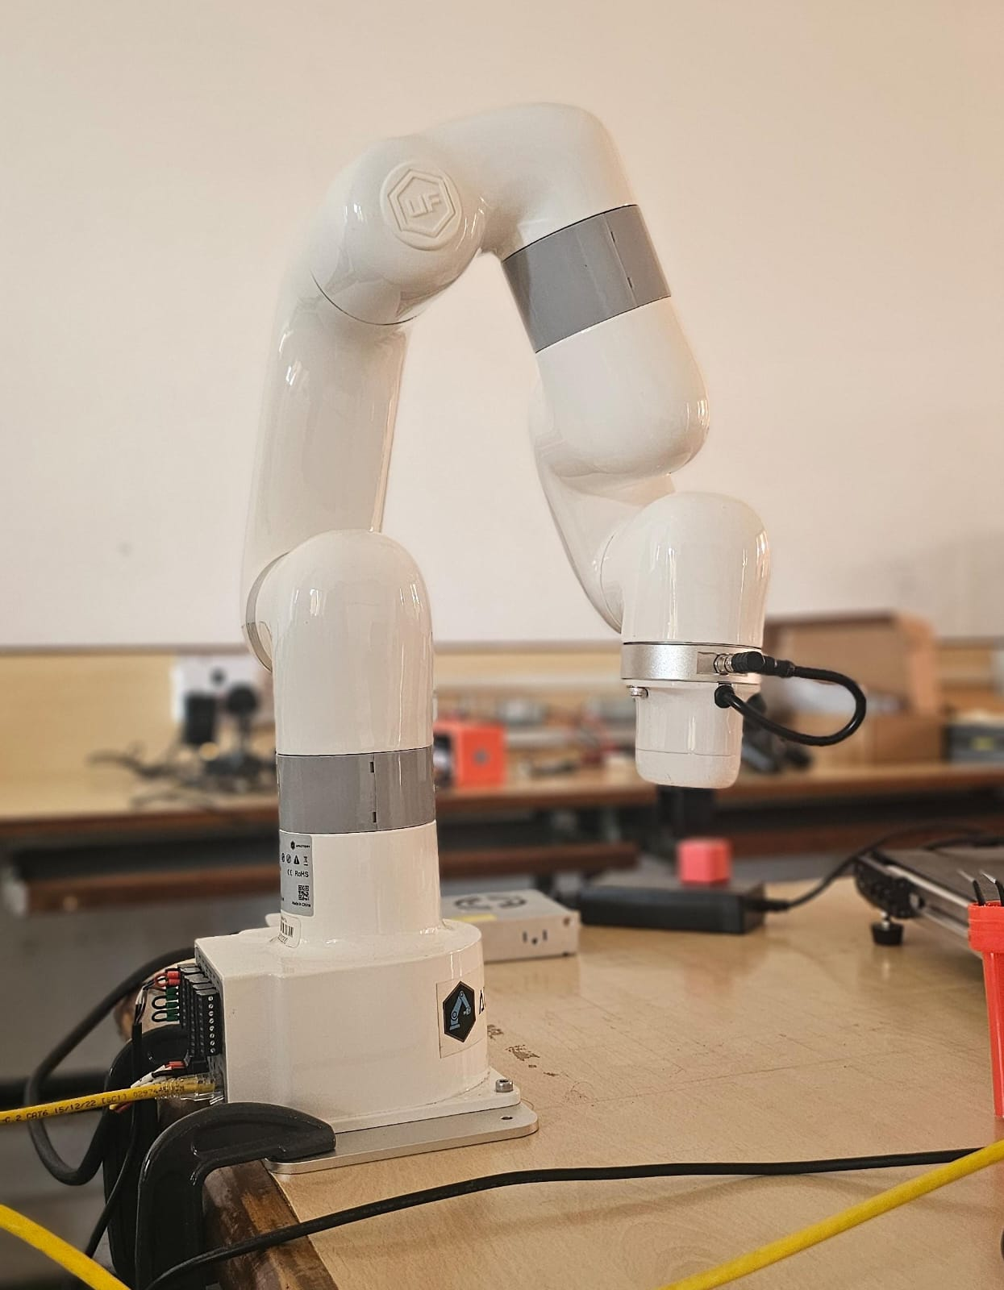
Hardware Requirements
Dobot Magician
Ufactory Lite 6

Slide 12
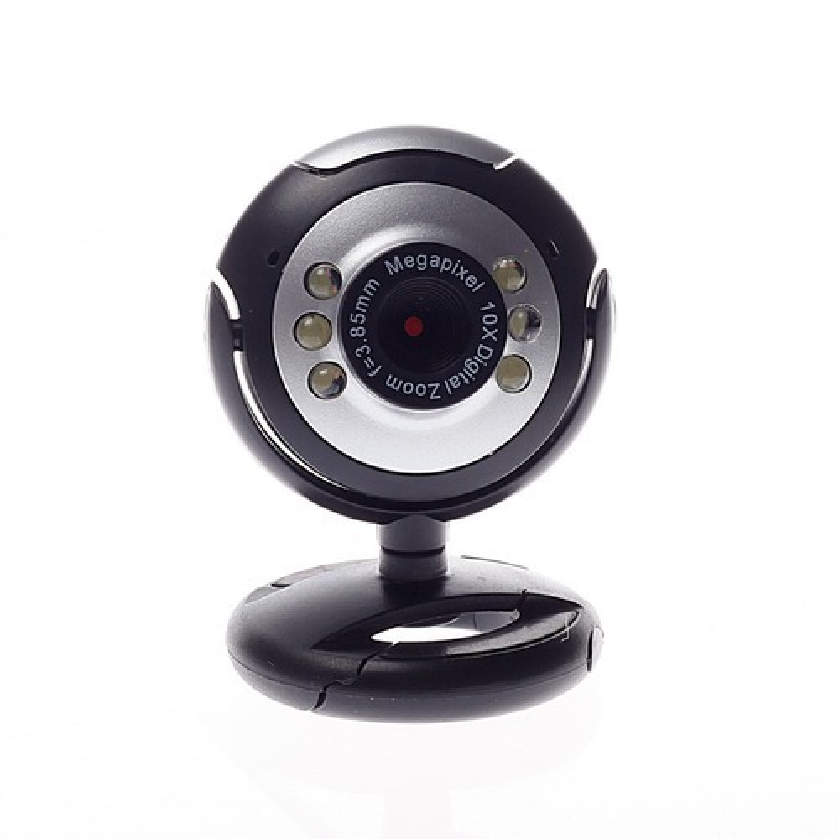
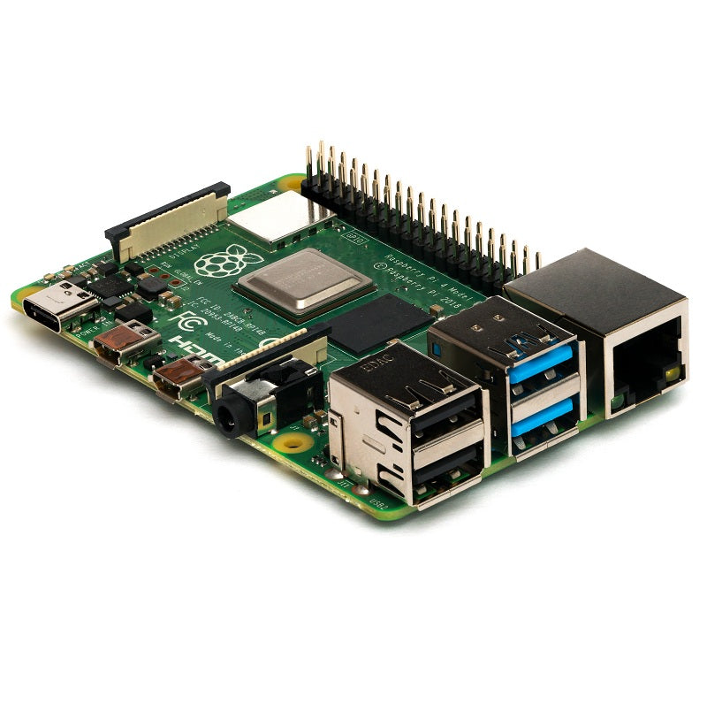
Hardware Requirements
Raspberry pi 4B
Web Camera

Slide 13
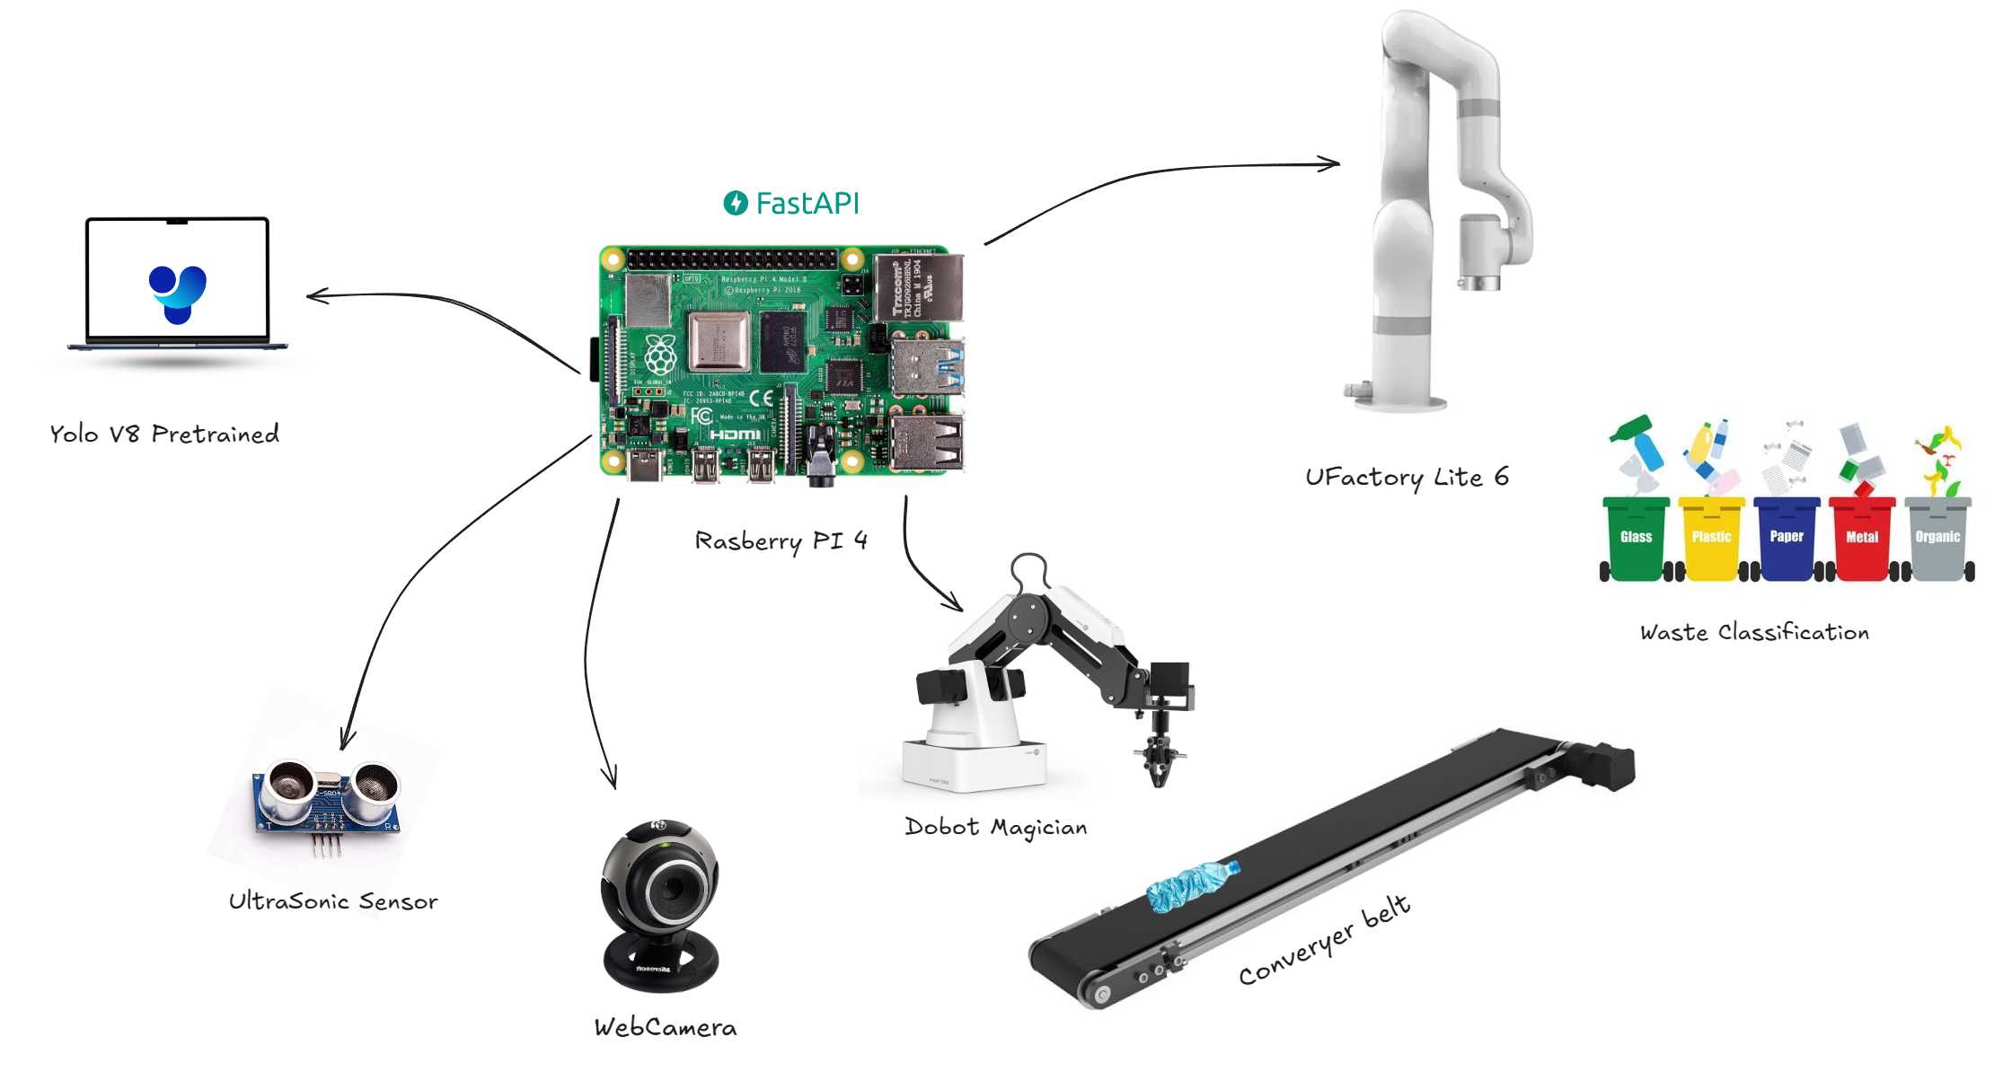
Hardware Architecture

Slide 14
Software Requirements
For Ufactory Lite 6
Ufactory Studio
For Dobot Magician
Dobot Lab
For object detection and segmentation
Transfer learning on Yolo v8
Object detection using Single Short Multibox Detection

Slide 15
Single Short Multibox Detector (SSD)
Model | Complexity | Speed | Efficiency | Accuracy | FPS
Yolo v8 | Medium | Fast | Efficient | Medium | 45
SSD | Low | Fast | Efficient | High | 59

Slide 16
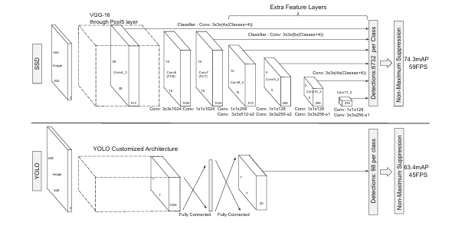
Model Architectures

Slide 17
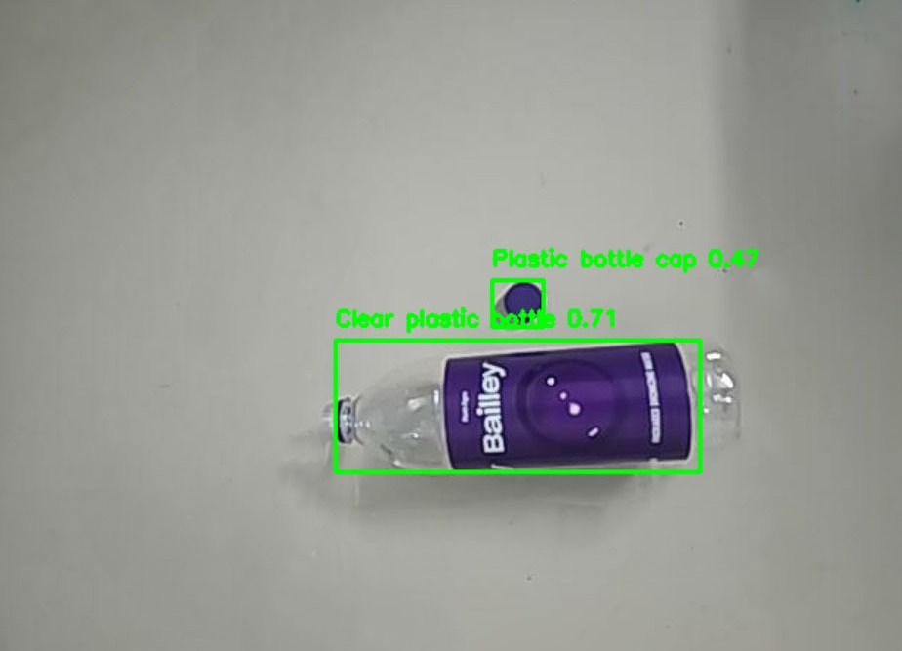
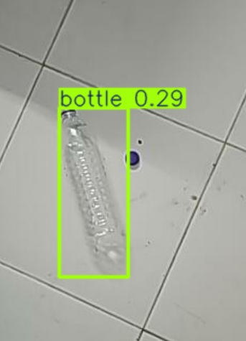
Default vs Finetuned Yolo v8
Finetuned model
Default model

Slide 18
Relevance in MFC-4
Object detection architectures for feature extraction and classification
Yolo v8
SSD
Forward kinematics
Inverse kinematics
Singularity analysis using the Jacobian matrix

Slide 19
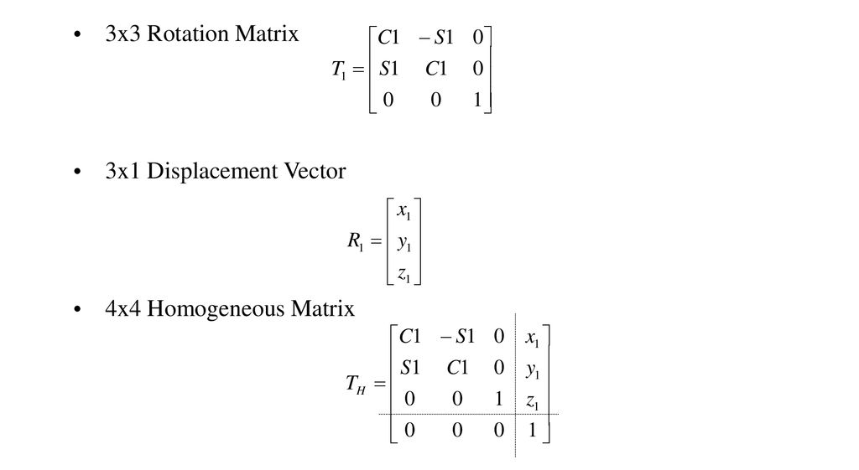
Homogeneous Transformation Matrix

Slide 20
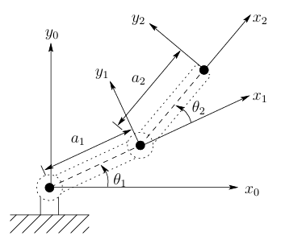
Forward Kinematics
Given the joint angles, forward kinematics gives the position of end effector in terms of a Homogeneous transform matrix

Slide 21
Inverse Kinematics
Given the end effector position, inverse kinematics tells us the joint angles
The Denavit-Hartenberg representation gives both the transformation for forward and inverse kinematics
Manipulator to be used:
Ufactory Lite 6 (6-DOF manipulator)

Slide 22
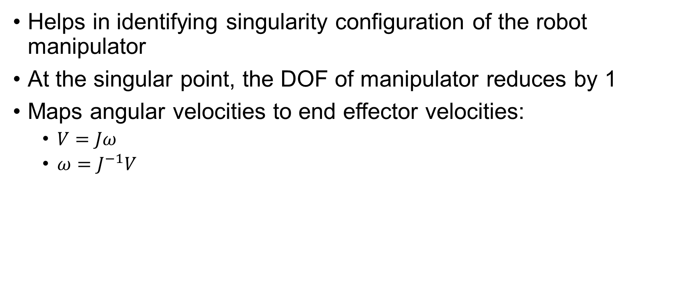
Jacobian Matrix
Helps in identifying singularity configuration of the robot manipulator
At the singular point, the DOF of manipulator reduces by 1
Maps angular velocities to end effector velocities:
$V=Jω$
$ω=J^{−1}V$

Slide 23
Timeline
1st Review
February
2nd Review
March
Task | 1 | 2 | 3 | 4 | 5 | 6 | 7 | 8 | 9 | 10 | 11
Literature review and problem statement formulation
Hardware and software selection for the system
Vision model and transfer Learning
Integrating camera with Ufactory Lite 6 arm
Using single short multibox detection
Programming Ufactory arm to pick the detected waste and place it in the designated place
Programming Dobot Magician to pick and place waste items in the conveyor belt
Integrating LLMs in to the workflow to have deeper insights about the composition of waste
UI to display waste classified and the ways it can be reused or disposed based on composition
Overall review of edge cases and identifying drawbacks in the system

